Slide 1
Batbot hovering by means of evolutionary algorithm
2023/03/18

Slide 2
TABLE OF CONTENT
Problem Statement
Evolutionary Algorithm
Batbot Flight Analysis
Static Test
Dynamic Test

Slide 3
Problem statement
Nature has provided several flying beings with a very advantageous ability for survival: Hovering.
Therefore:
Goal: We attempt to provide our Batbot with the capability of hovering.
Problem: Developing control strategies on a flapping robot is very complex. Specially considering that the wings of the Batbot are made of an elastic membrane, which makes simulations difficult and computationally expensive.
Solution: Develop a testing framework, were the Batbot can use an Evolutionary Algorithm, namely Covariance Matrix Adaptation (EA-CMA), to optimize its control parameters by trial and error using real flight information.

Slide 4
Evolutionary algorithm
Evolutionary Algorithms, are algorithms inspired in natural selection. It proposes a generation of solutions, which are then evaluated using a fitness function. The “fitness” of each solution is used to generate better offspring in the next generation until an optimal solution is encountered.
Advantages:
One of the greatest advantaged of EA, compared to other Machine Learning Models, is that it enables the free choice of the fitness function.
EA-CMA uses a Covariance Matrix to generate the next generation of solutions, which is then optimized based in all the results obtained from the fitness functions. This is very efficient as it also uses information from bad performing solutions and it restricts the search domain, which is particularly important in higher dimensional optimization problems.
Disadvantages:
Finding and optimal solution can take several generations. Which is problematic when using a real robot for the trials, as it may take a lot of time.
Solution: To overcome this problem, we subdivided the problem in three simpler tasks, whose result is used by the next task, to assure a quicker convergence to an optimal solution:
1st Flight Parameter Analysis → 2nd Static Test → 3rd Dynamic Test

Slide 5

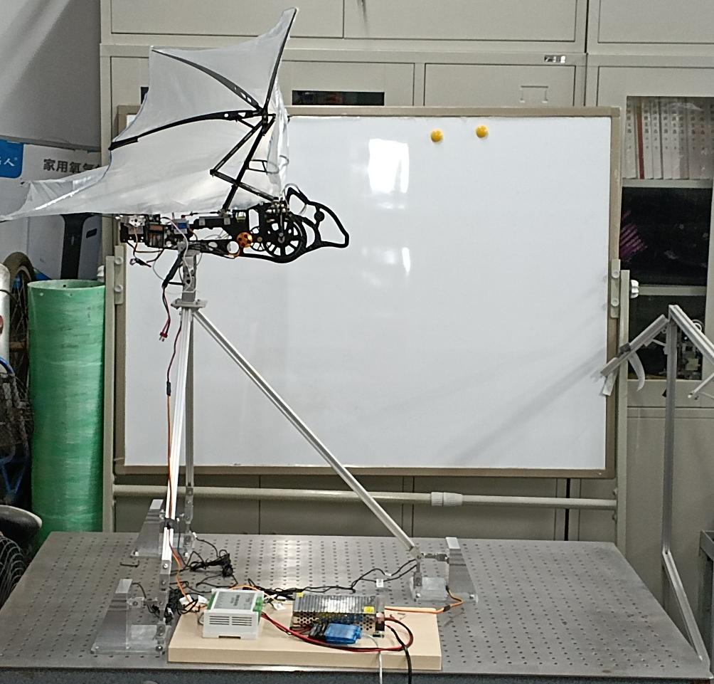
EA-CMA General WORKFLOW
Computer running EA-CMA
1st Step: Computer uses EA-CMA to propose n solutions from Covariance Matrix
2nd Step: n tests are carried out. Sensors send measurements back to computer.
n measurements
n solutions
3rd Step: From measurements the fitness function calculate scores and optimizes Covariance Matrix.
n Tests in Testbench

Slide 6
1st Sub-task: Flight parameter analysis
First we carry out an analysis of the flight parameters of the Batbot using a static test-bench, here we command the Batbot, which is attached to the test-bench, to do different flight maneuvers and measure the resulting forces and torques applied to the Batbot.
The results will provide a better understanding of how will the Batbot behave during flight. Which will be the starting point of the next sub-task.

Slide 7
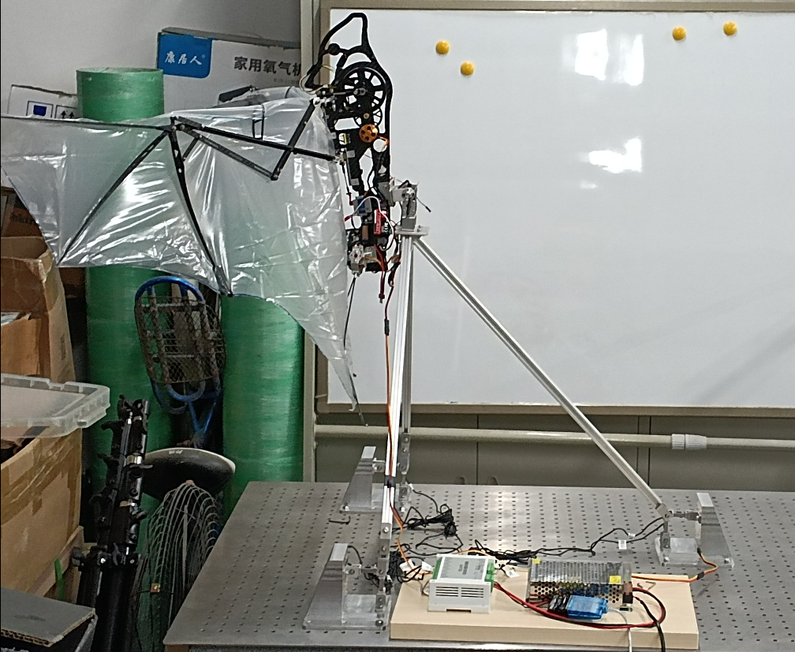
2nd Sub-task: Static test
In the static test, we set the Batbot in hovering position and use the EA-CMA to find to optimal commands that would make the Batbot resemble a hovering flight.
In this case, the fitness function evaluates how much force is perceived by the measurements sensors, assuming that when the values are close to zero, hovering is happening. The result of this test delivers only forward commands, controlling will be learned in the next test were flight sensors are incorporated

Slide 8
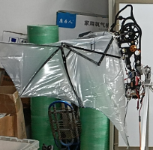

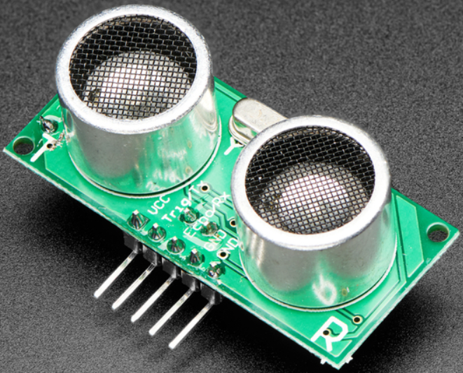
3rd sub-task: Dynamic test
In the Dynamic Test, a test-bench will be developed that allows the Batbot to fly without any static attachments to the test-bench. The Batbot will hang from a string that is connected to a force sensor to measure if the Batbots hangs or not, the position of the Batbot will also be monitored. In this test, the fitness function will consist on eliminating the force on the string whilst staying in the same position. Instead of optimizing flight commands, in the Dynamic Test controlling strategies, which use flight sensors, will be optimized.

Slide 9
Thank you!
Does anyone have any questions?
addyouremail@greatppt.com
+00 000 000 000
www.greatppt.com

